Slide 1
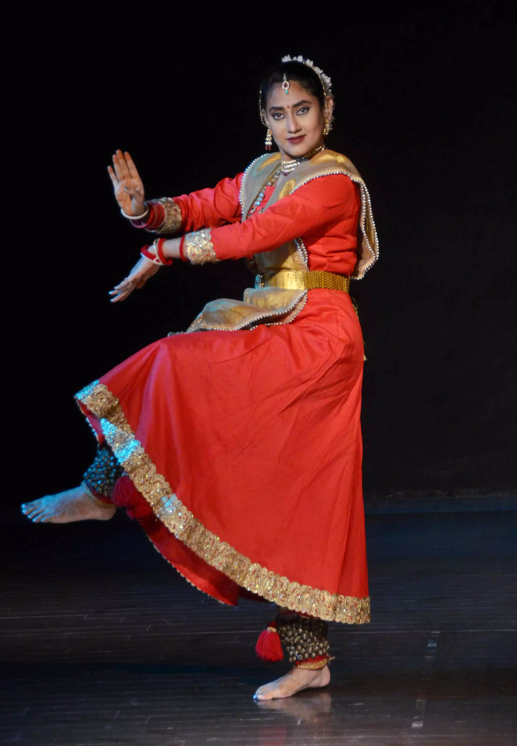


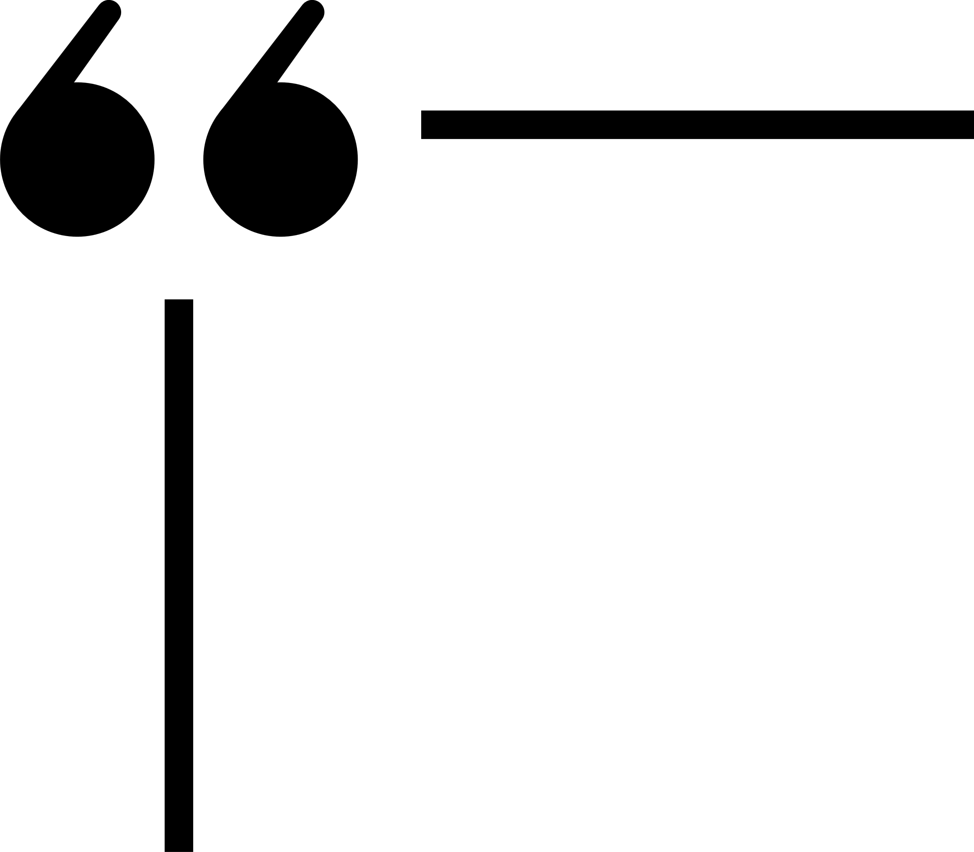

House of Natwari Nritya
HOUSE OF NATWARI NRITYA
Khushi Chavan - 60004190061
Glen Dhingra - 60004200045
Ahmed Solkar - - 60004200057
Bringing learning home
Mentored and Guided By:
Prof. Nilesh Patil

Slide 2
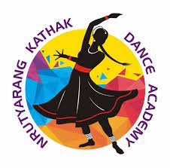



House of Natwari Nritya
Current System
Dance Academy
Youtube Videos
Mobile Apps

Slide 3
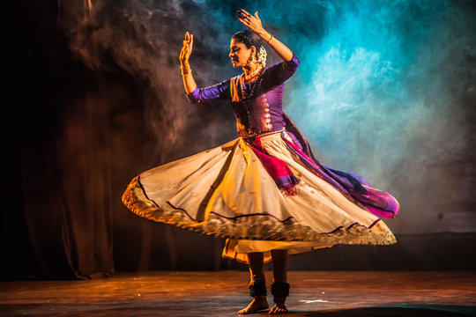
House of Natwari Nritya
Proposed System
Helps an individual explore the classical dance culture free of cost.
Helps every individual to learn from the basics step by step.
Corrects the postures and body movements in real-time.

Slide 4
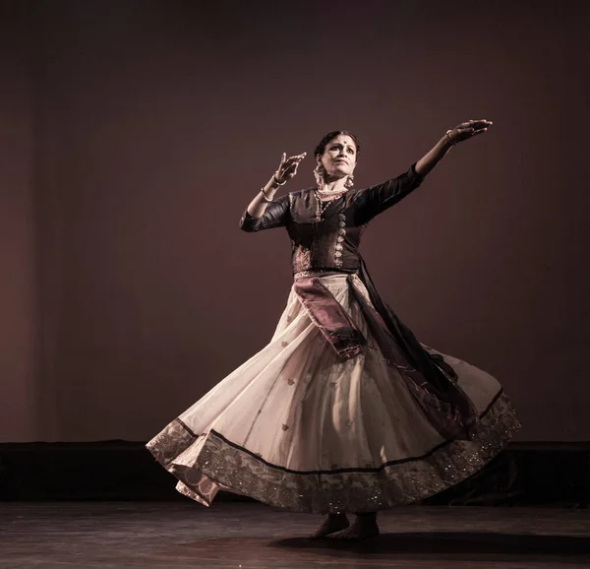

House of Natwari Nritya
OBJECTIVES
Dance academies are expensive and the schedule is rigid and uncompromising.
Dance apps and videos are one-dimensional.
01
Objective is to encourage people to study Indian traditional dance
02
Creating a free, flexible, and easy-to-access classical dance learning app.
03
Objective is to encourage people to study Indian traditional dance

Slide 5


House of Natwari Nritya
SCOPE OF THE PROJECT
Give someone instructions on how to perform dance steps at all levels, from beginner to advanced.
Address any errors that an individual makes when performing dance moves.
01
02

Slide 6

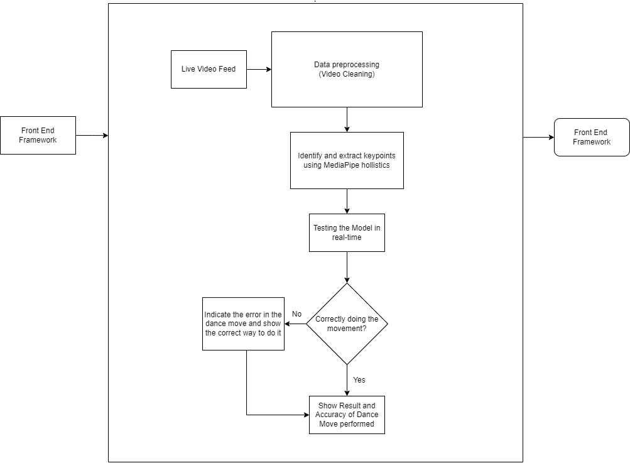
House of Natwari Nritya
ARCHITECTURAL
DIAGRAM

Slide 7
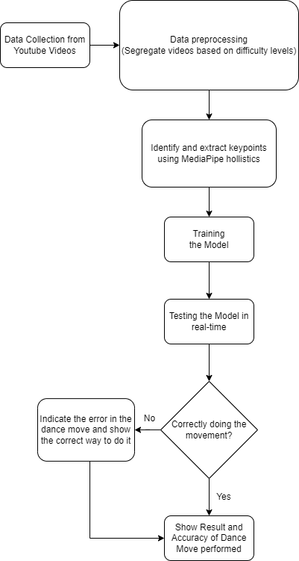
House of Natwari Nritya
PROPOSED
METHODOLOGY
MediaPipe is a framework that is used to build machine learning pipelines to process time-series data like audio, video, etc.
It is a cross-platform framework that works on Android, Desktop/Server, iOS and embedded devices like Raspberry Pi and Jetson Nano.

Slide 8
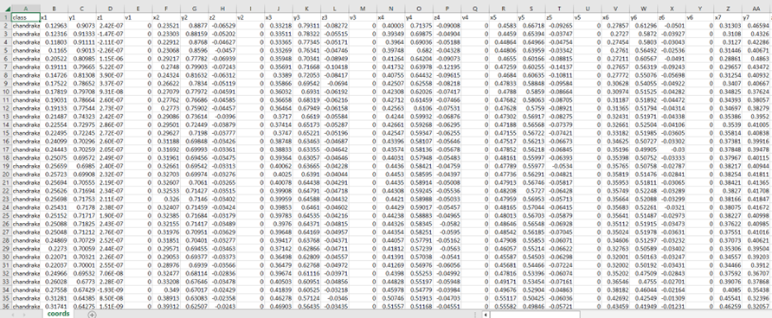
House of Natwari Nritya
DATASET

Slide 9
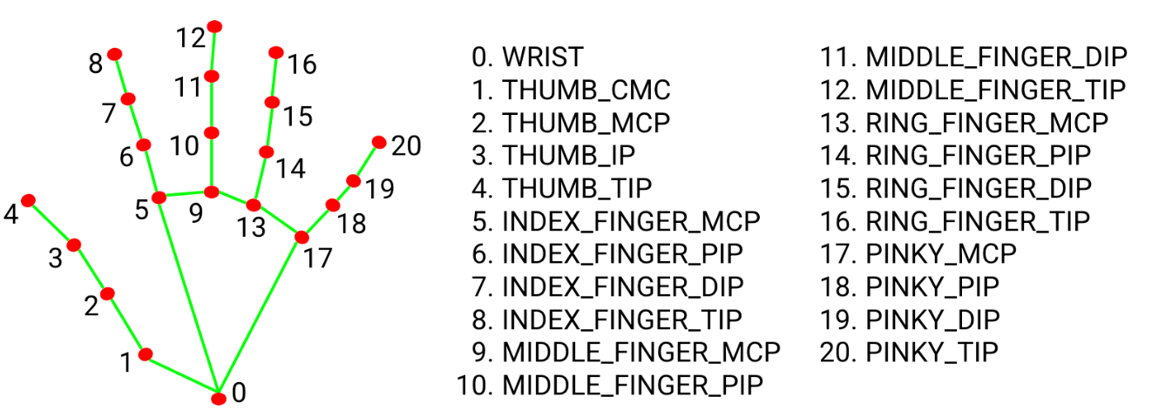
House of Natwari Nritya
IMPLEMENTATION:

Slide 10
House of Natwari Nritya
IMPLEMENTATION
We use Random Forest Classifier, Logistic Regression and Ridge Classifier on the dataset for training our model. Later, these three models are compared by testing to determine which model best suits our purpose.
Random Forest Classifier works better than Logistic Regression and Ridge Classifier as the model is being trained on high-dimensional data. As Random Forest Classifier is based on trees, it doesn't matter by the variables scale. Bagging and random subspace method are used to prevent overfitting. It also supports automatic feature selection. Due to the above-mentioned reasons, Random Forest Classifier is best suited for this project.
Accuracy received after training and testing models are:
Logistic Regression - 0.92
Ridge Classifier - 0.91
Random Forest Classifier - 0.95

Slide 11
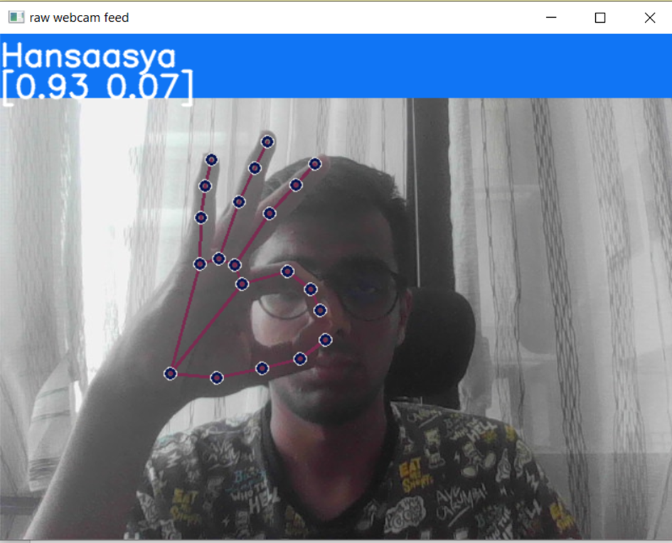
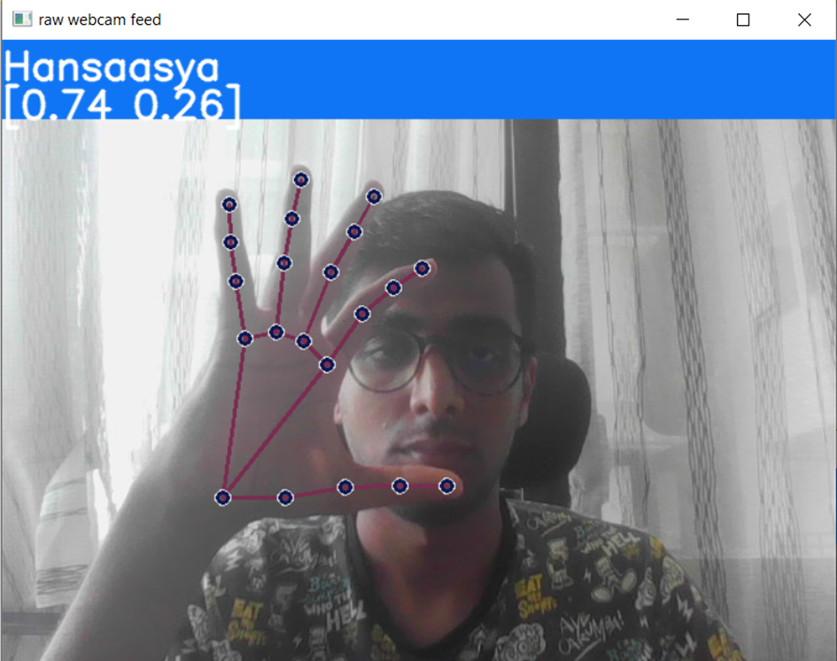
House of Natwari Nritya
REAL TIME TESTING
Right Hand Hansaasya Mudra

Slide 12
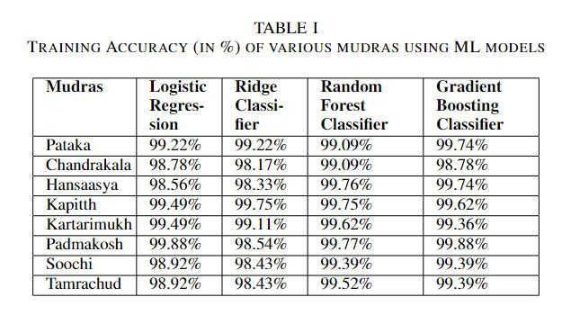
House of Natwari Nritya
RESULTS

Slide 13
House of Natwari Nritya
IMPLEMENTATION
MediaPipe Framework will extract the key points of various body parts from the user's video or live feed.
In addition to calculating critical aspects, the angle between different body parts is computed.
We use Fast Dynamic Time Warping with Cosine distance as a measure of similarity to compare motions. Fast Dynamic Time Warping (Fast DTW) compares two variable-speed temporal time series sequences.
It employs the method of dynamic programming to identify the optimal temporal fit between the components of two-time series. Fast DTW could identify similarities in walking, for instance, even if one individual was walking faster than the other or if accelerations and decelerations occurred during an observation.
Using Cosine distance without Fast DTW, we compare the amplitudes of two time series at time T using Cosine distance.
Suppose both time series are highly similar in form but out of phase in time. In that case, the score for comparison and similarity will be low.
Fast DTW compares the amplitude of the first time series at time T to the amplitude of the second time series at times T+1 and T-1 or T+2 and T-2.

Slide 14
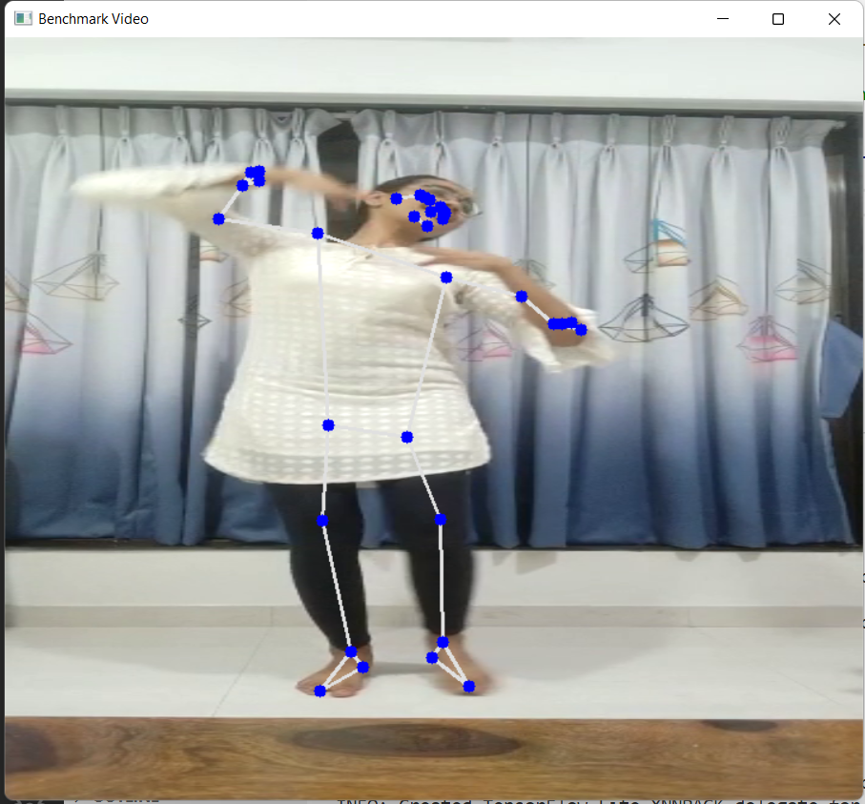
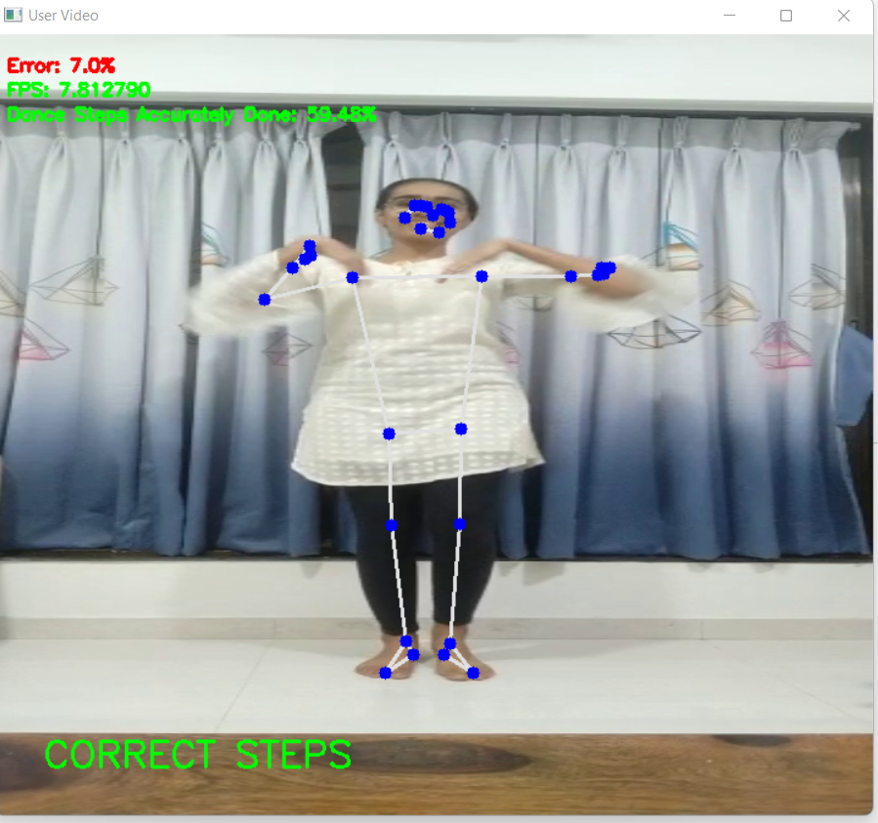
House of Natwari Nritya
REAL TIME TESTING
Frame of Benchmark Video
Frame of User Video

Slide 15
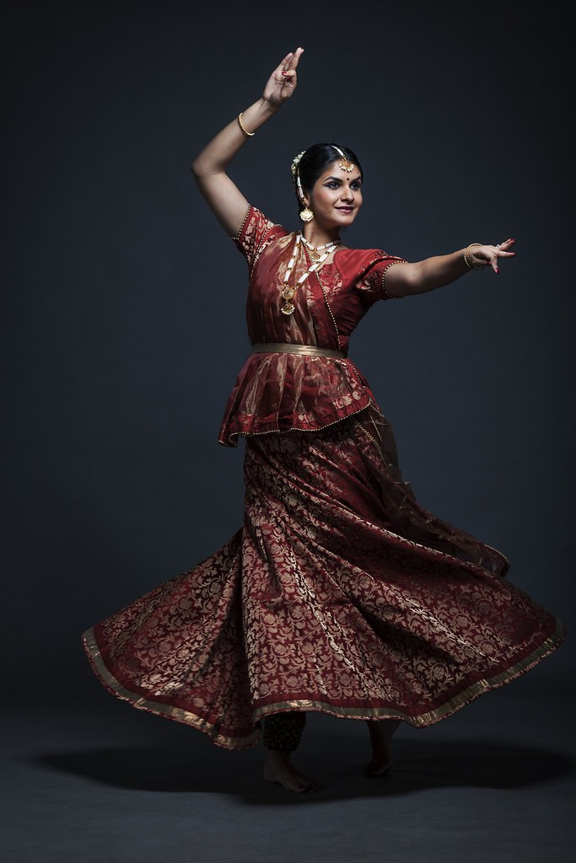
CONCLUSION
Current options are only joining Dance Academy or learning through Youtube Videos.
The former is expensive and inconvenient due to time constraints while the latter is not reliable.
The proposed solution eliminates the above issues and incorporates both of their benefits.

Slide 16
House of Shastriya Nritya
REFERENCES
[1] Y. Chen, R. Du, K. Luo and Y. Xiao, ”Fall detection system based on real-time pose estimation and SVM” , 2021 IEEE 2nd International Conference on Big Data, Artificial Intelligence and Internet of Things Engineering (ICBAIE), 2021, pp. 990-993, doi:10.1109/ICBAIE52039.2021.9390068.
[2] Krishna Mohan Kudiri, Abas Md Said and M Yunus Nayan, "Human Emotion Detection through Speech and Facial Expressions", 2014 International Conference on Computer Assisted System in Health, 2014, pp. 26-31, doi: 10.1109/CASH.2014.22.
[3] Z. Zhai, "Gesture Interaction System Design for Telerehabilitation Based on Mediapipe", 2022 IEEE 2nd International Conference on Software Engineering and Artificial Intelligence (SEAI), 2022, pp. 279-283, doi: 10.1109/SEAI55746.2022.9832111.
[4] V. H. Iyer, U. M. Prakash, A. Vijay and P. Sathishkumar, "Sign Language Detection using Action Recognition", 2022 2nd International Conference on Advance Computing and Innovative Technologies in Engineering (ICACITE), 2022, pp. 1682-1685, doi: 10.1109/ICACITE53722.2022.9823484.
[5] Aouaidjia Kamel, Bowen Liu, Ping Li & Bin Sheng (2019) "An Investigation of 3D Human Pose Estimation for Learning Tai Chi: A Human Factor Perspective", International Journal of Human–Computer Interaction, 35:4-5, 427-439, DOI: 10.1080/10447318.2018.1543081
[6] Kahol,K.,Tripathi, P. and Panchanathan, S. 2004. Automated gesture segmentation from dance sequences. In Automatic Face and Gesture Recognition, In Automatic Face and Gesture Recognition. Proceedings. Sixth IEEE International Conference on, pages 883–888. IEEE.
[7] Raptis, M., Kirovski, D. and Hoppe, H. 2011. Realtime classification of dance gestures from skeleton animation. In Proceedings of the 2011 ACM SIGGRAPH/Eurographics Symposium on Computer Animation, pages 147–156. ACM.
[8] Hariharan, D., Acharya, T., and Mitra,S.2011. Recognizing hand gestures of a dancer. In Pattern recognition and machine intelligence, pages 186–192. Springer.
[9] Heryadi, Y., Fanany, M.I. and Arymurthy, A. M. 2012. Grammar of dance gesture from bali traditional dance. International Journal of Computer Science Issues (IJCSI), 9(6).

